Slide 1




Slide 2

NETWORKING

Slide 3
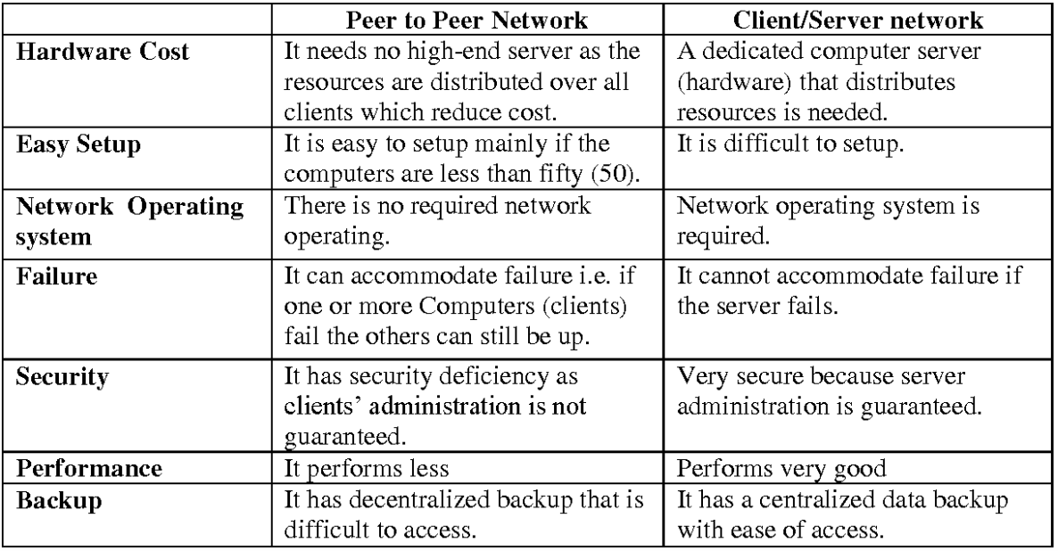
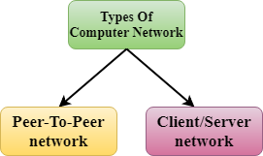
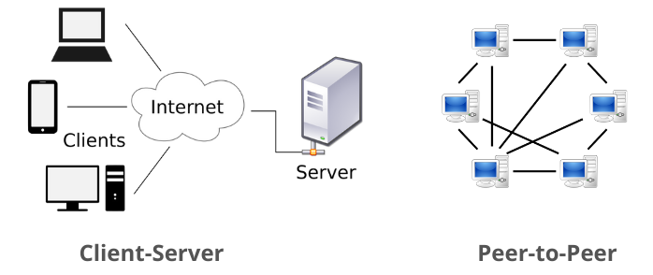
NETWORKING
Architecture
Computer Network Architecture is defined as the physical and logical design of the software, hardware, protocols, and media of the transmission of data. Simply we can say that how computers are organized and how tasks are allocated to the computer.

Slide 4
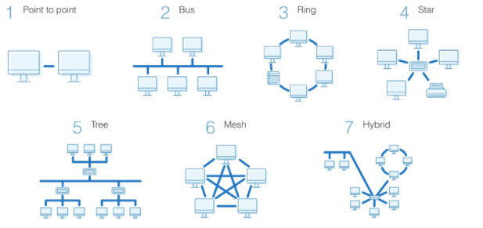
NETWORKING
Topologies
Topology defines the structure of the network of how all the components are interconnected to each other.
There are two types of topology: physical and logical topology.

Slide 5
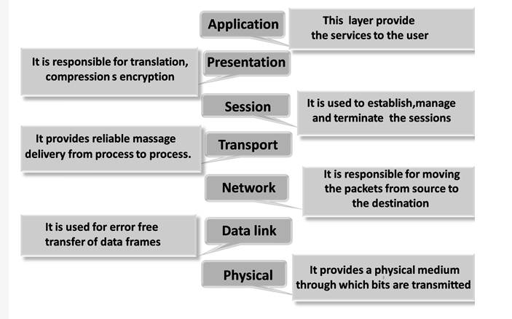
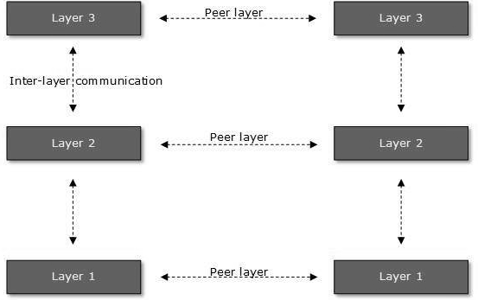
NETWORKING
OSI model

Slide 6
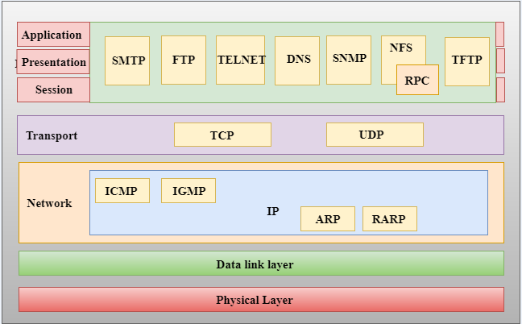
NETWORKING

Slide 7
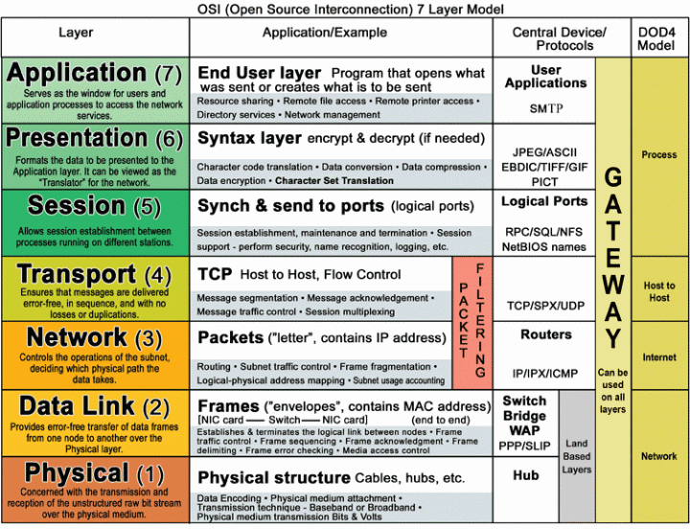
NETWORKING

Slide 8
NETWORKING
Network Layer
Routing: When a packet reaches the router's input link, the router will move the packets to the router's output link. For example, a packet from S1 to R1 must be forwarded to the next router on the path to S2.
Logical Addressing: The data link layer implements the physical addressing and network layer implements the logical addressing. Logical addressing is also used to distinguish between source and destination system. The network layer adds a header to the packet which includes the logical addresses of both the sender and the receiver.
Internetworking: This is the main role of the network layer that it provides the logical connection between different types of networks.
Fragmentation: The fragmentation is a process of breaking the packets into the smallest individual data units that travel through different networks.

Slide 9
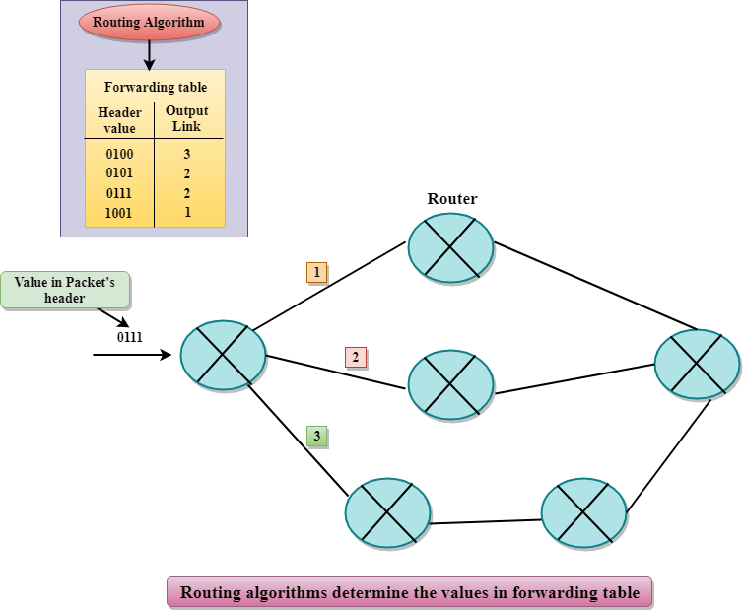
NETWORKING
Routing in the network layer

Slide 10
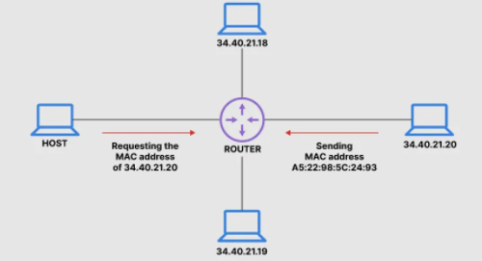

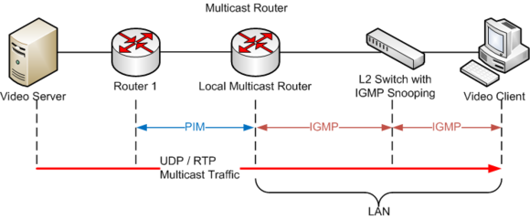
NETWORKING
Protocols: ARP, RARP and ICMP

Slide 11
NETWORKING
Transport Layer
The main role of the transport layer is to provide the communication services (logical communication) directly to the application processes running on different hosts
The transport layer protocols are implemented in the end systems but not in the network routers.
All transport layer protocols provide multiplexing/demultiplexing service. It also provides other services such as reliable data transfer, bandwidth guarantees, and delay guarantees.
Applications make use of either TCP/UDP and read and write to the transport layer

Slide 12
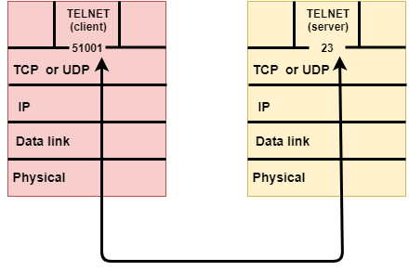
NETWORKING
Transport Layer

Slide 13
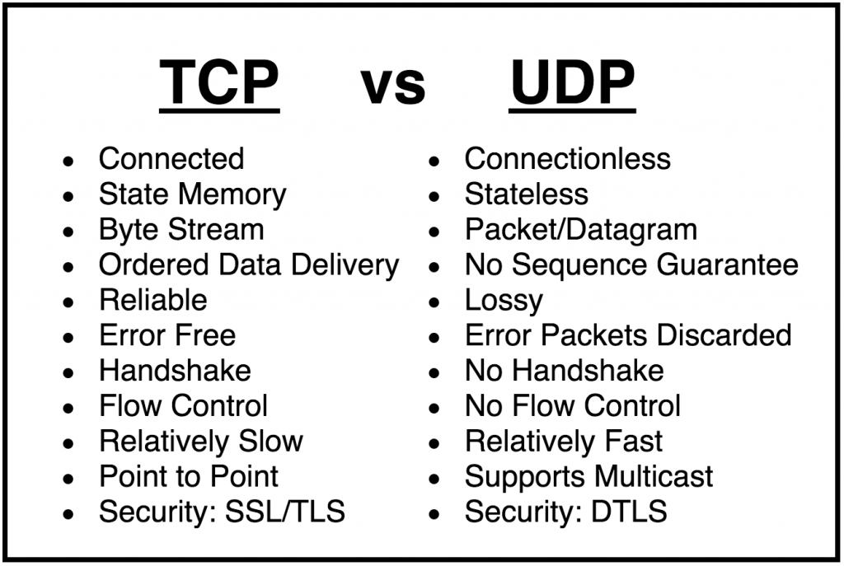
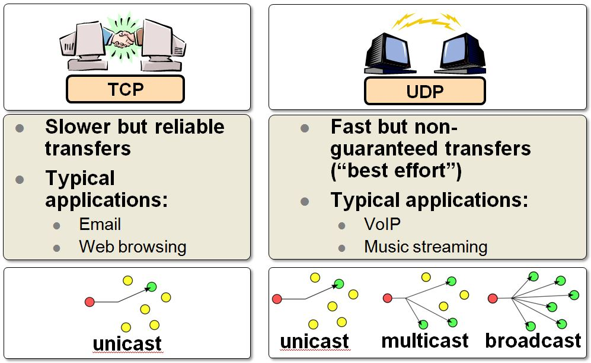
NETWORKING
Transport Layer

Slide 14
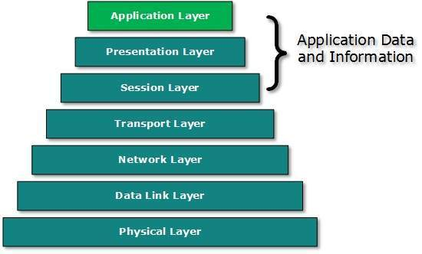
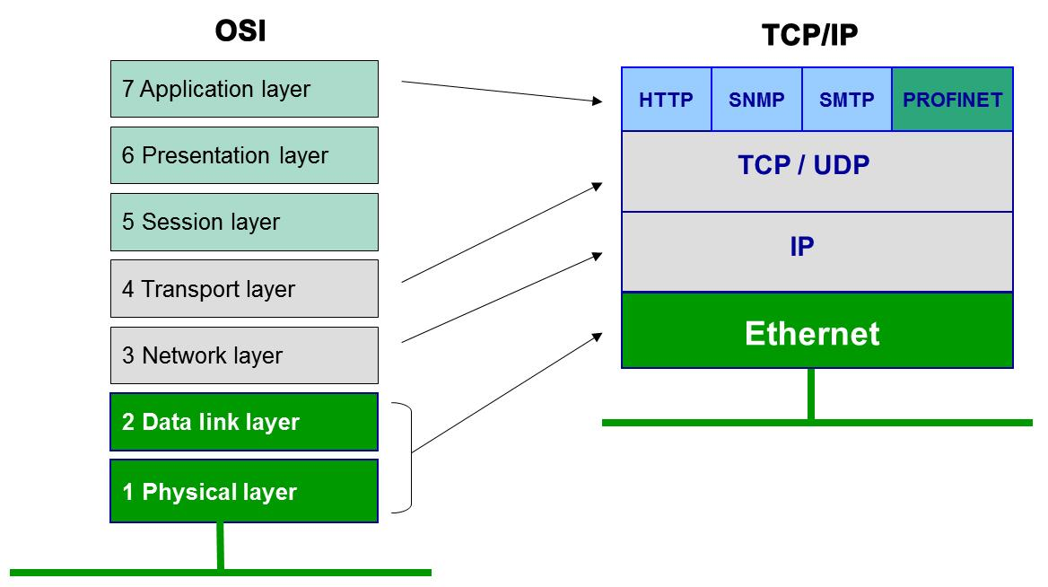
NETWORKING
Application Layer

Slide 15
NETWORKING
Application Layer Protocols
Domain Name System (DNS)
Simple Mail Transfer Protocol (SMTP)
File Transfer Protocol (FTP)
Post Office Protocol (POP)
Hyper Text Transfer Protocol (HTTP)
Transport Layer Security (TLS)

Slide 16
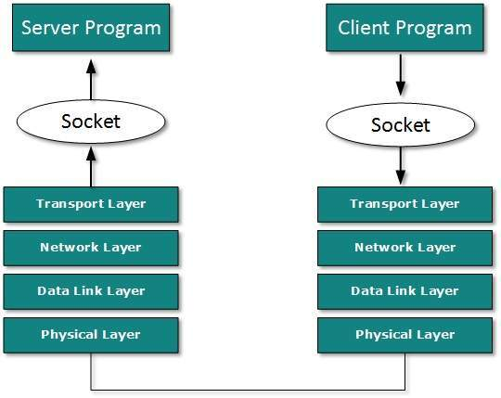
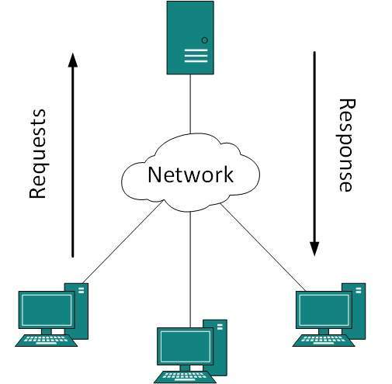
NETWORKING
Client Server Model

Slide 17
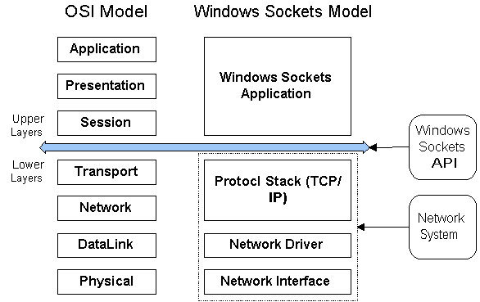
NETWORKING
Example: The WinSock Network model

Slide 18
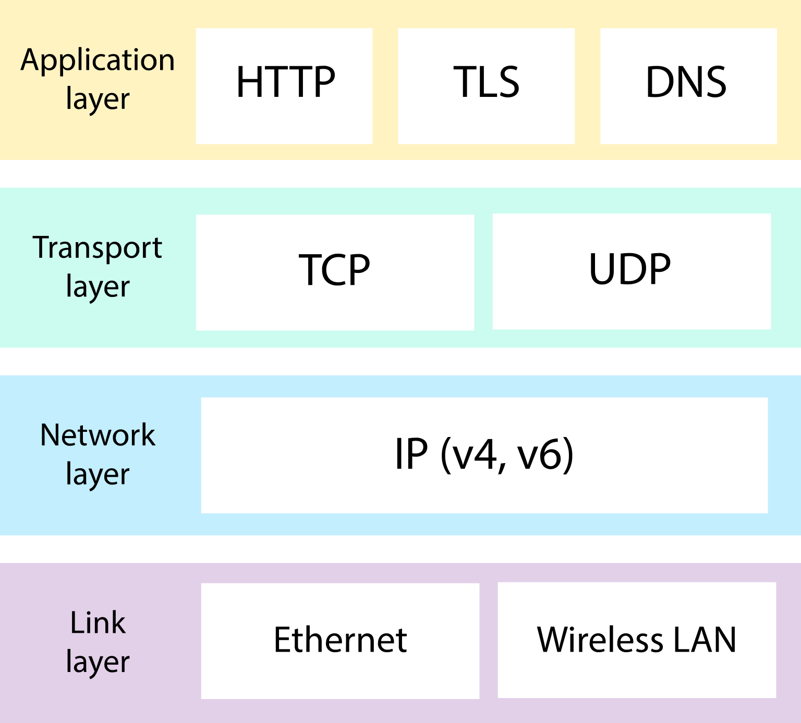
NETWORKING
Summary

Slide 19
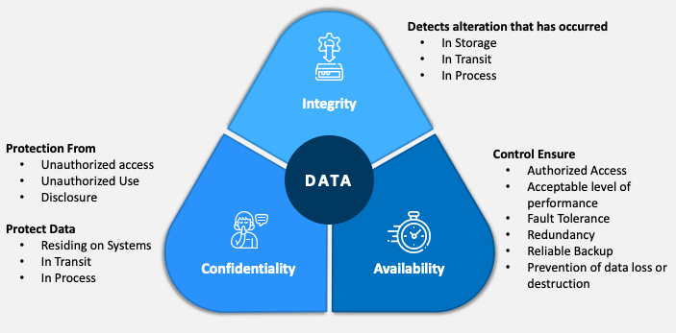
SECURITY
The CIA Triad

Slide 20
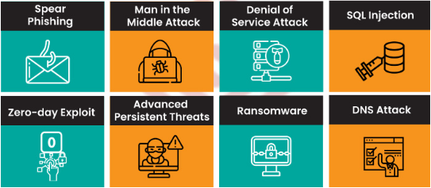
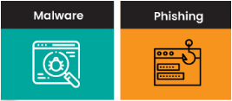
SECURITY
Types of Security Threats

Slide 21
SECURITY
Spearfishing
Spear phishing is an email or electronic communications scam targeted towards a specific individual, organization or business. Although often intended to steal data for malicious purposes, cybercriminals may also intend to install malware on a targeted user’s computer
Man in the Middle attack
is a cyberattack where the attacker secretly relays and possibly alters the communications between two parties who believe that they are directly communicating with each other, as the attacker has inserted themselves between the two parties
Denial of Service Attack
Denial-of-service attack (DoS attack) is a cyber-attack in which the perpetrator seeks to make a machine or network resource unavailable to its intended users by temporarily or indefinitely disrupting services of a host connected to a network. Denial of service is typically accomplished by flooding the targeted machine or resource with superfluous requests in an attempt to overload systems and prevent some or all legitimate requests from being fulfilled. In a distributed denial-of-service attack (DDoS attack), the incoming traffic flooding the victim originates from many different sources. This effectively makes it impossible to stop the attack simply by blocking a single source.
In DNS attacks, hackers will sometimes target the servers which contain the domain names. In other cases, these attackers will try to determine vulnerabilities within the system itself and exploit them for their own good.

Slide 22
SECURITY
SQL Injection
SQL injection usually occurs when you ask a user for input, like their username/userid, and instead of a name/id, the user gives you an SQL statement that you will unknowingly run on your database.
Zero Day Exploits
A zero-day (also known as 0-day) is a computer-software vulnerability either unknown to those who should be interested in its mitigation (including the vendor of the target software) or known and a patch has not been developed. Until the vulnerability is mitigated, hackers can exploit it to adversely affect programs, data, additional computers or a network. An exploit directed at a zero-day is called a zero-day exploit, or zero-day attack.
Advanced Persistent Threats
An advanced persistent threat (APT) is a stealthy threat actor, typically a nation state or state-sponsored group, which gains unauthorized access to a computer network and remains undetected for an extended period.
In recent times, the term may also refer to non-state-sponsored groups conducting large-scale targeted intrusions for specific goals

Slide 23
SECURITY
Ransomware
Ransomware is a type of malware from cryptovirology that threatens to publish the victim's personal data or perpetually block access to it unless a ransom is paid. While some simple ransomware may lock the system so that it is not difficult for a knowledgeable person to reverse, more advanced malware uses a technique called cryptoviral extortion.
DNS Attack
DNS -> Domain Name Server is a prominent building block of the Internet. It’s developed as a system to convert alphabetical names into IP addresses, allowing users to access websites and exchange e-mails. DNS is organized into a tree-like infrastructure where the first level contains topmost domains, such as .com and .org. The second-level nodes contain general, traditional domain names. The ‘leaf’ nodes on this tree are known as hosts.
Malware
A malware attack is a common cyberattack where malware (normally malicious software) executes unauthorized actions on the victim's system. The malicious software (a.k.a. virus) encompasses many specific types of attacks such as ransomware, spyware, command and control, and more
Phishing
Phishing is a type of social engineering where an attacker sends a fraudulent (e.g., spoofed, fake, or otherwise deceptive) message designed to trick a human victim into revealing sensitive information to the attacker or to deploy malicious software on the victim's infrastructure like ransomware
Note that Social engineering is the psychological manipulation of people into performing actions or divulging confidential information.

Slide 24
SECURITY
Phishing
Phishing is a type of social engineering where an attacker sends a fraudulent (e.g., spoofed, fake, or otherwise deceptive) message designed to trick a human victim into revealing sensitive information to the attacker or to deploy malicious software on the victim's infrastructure like ransomware
Note that Social engineering is the psychological manipulation of people into performing actions or divulging confidential information.

Slide 25




THANK YOU
+91 78150 95095
codemithra@ethnus.com
www.codemithra.com

